Slide 1
MINI PROJECT ON
GUESS A NUMBER

Slide 2
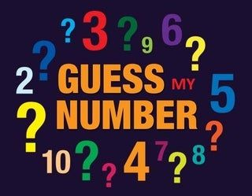
introduction
The number guessing game is a simple guessing game where a user is supposed to guess a number between 0 and n in a maximum attempts. The game will end after the maximum attempts and if the player is failed to guess the number , and then he loses the game.

Slide 3
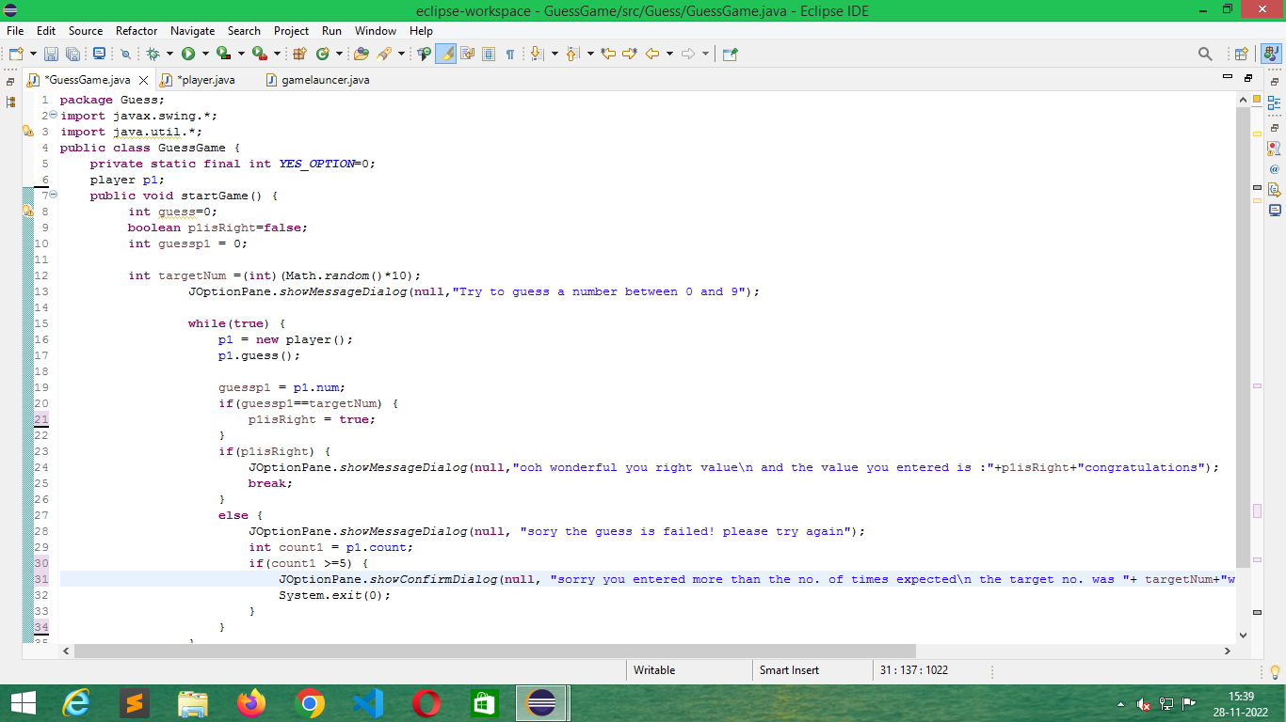

Slide 4
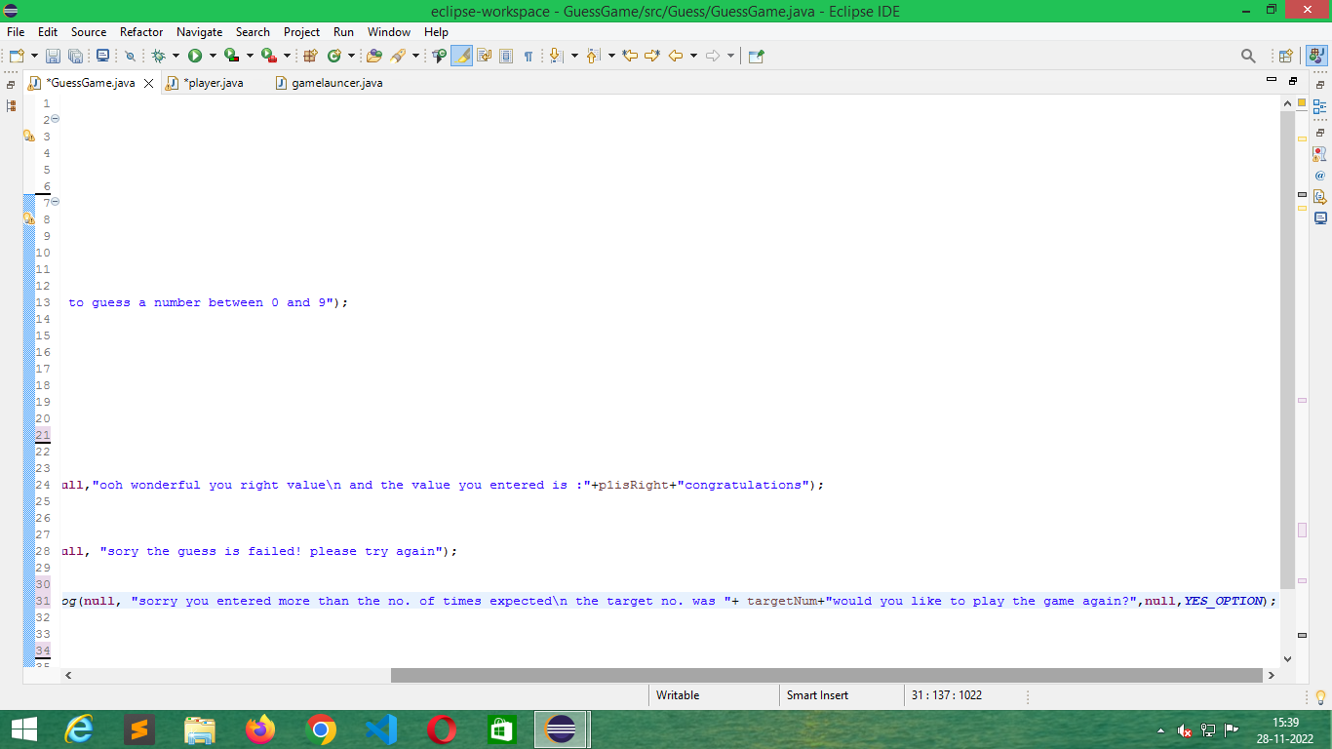

Slide 5
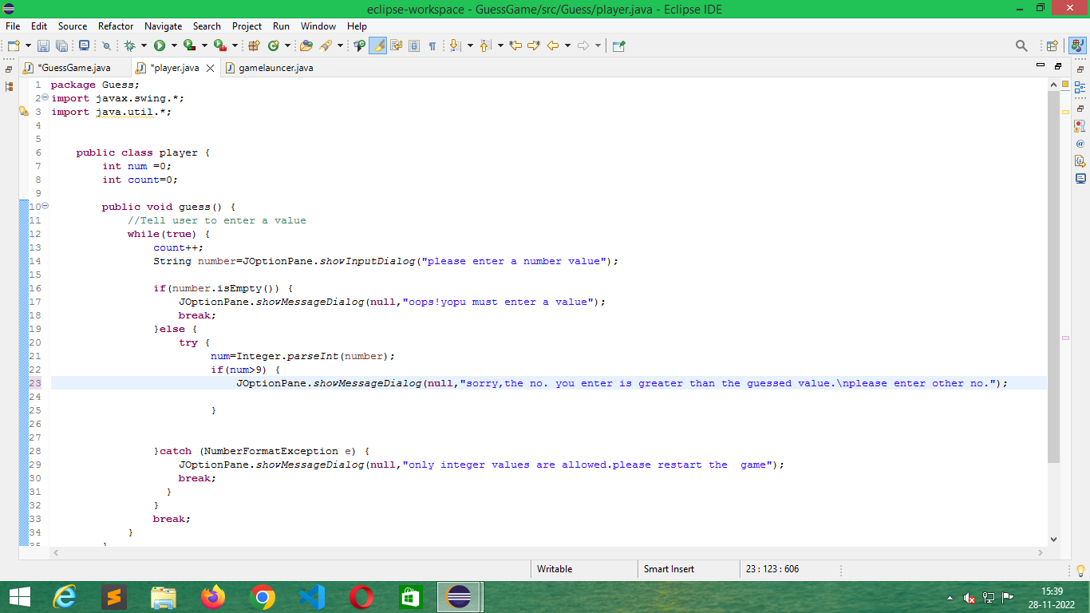

Slide 6
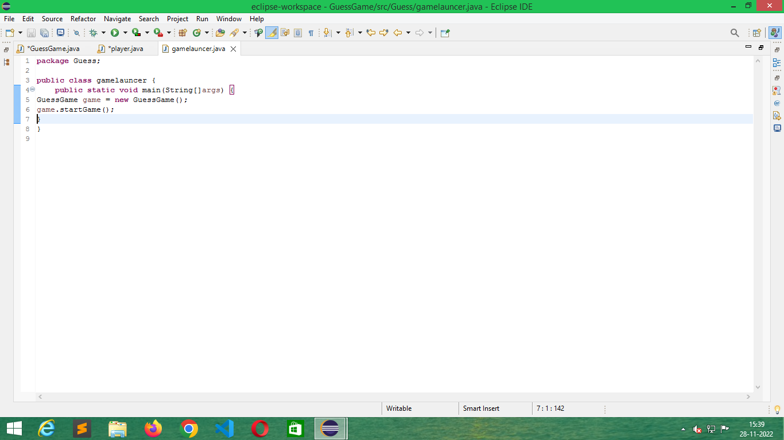

Slide 7
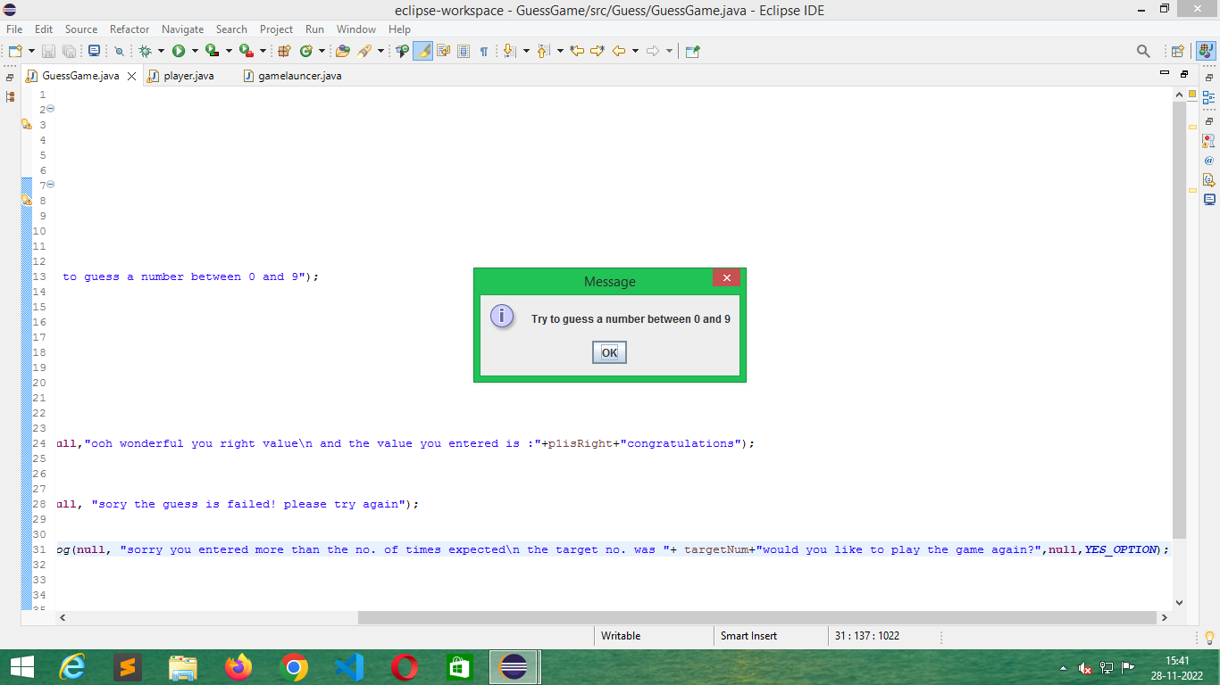

Slide 8
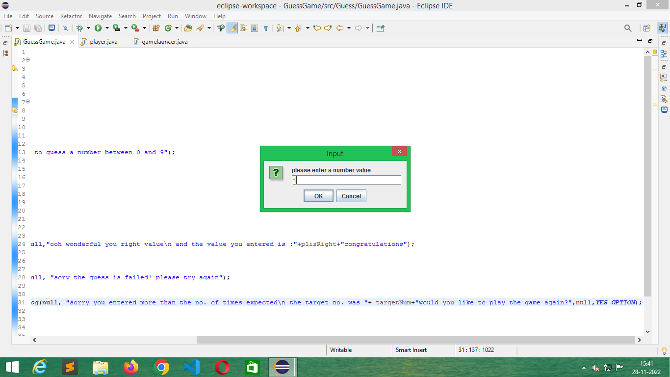

Slide 9


Slide 10
THANK YOU
presented by
Nithya sree.V
K.Rohini
Harini.B
K.Vinuthna

